Slide 1
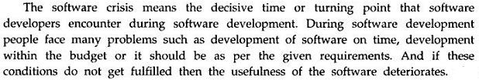
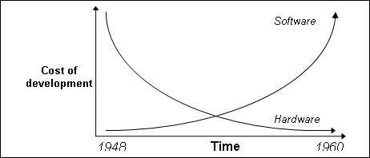
Software Crisis
Software crisis is a term used in the early days of computing science for the difficulty of writing useful and efficient computer programs in the required time.

Slide 2
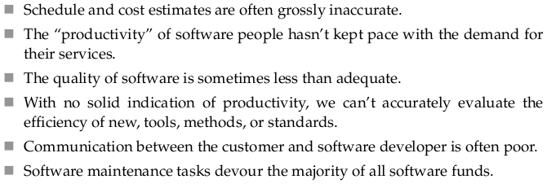
Problems faced by Customers due to S/W Crisis

Slide 3
Software Crisis
S/W crisis from programmer point of view:-
i)Problem of compatibility.
ii)Problem of Portability.
iii)Proclaiming documentation.
iv)Problem of pirated s/w.
v)Problem in co-ordination of work of different people. vi)Problem of proper maintenance.
S/W crisis from user point of view:-
i) s/w cost is very high.
ii)Price of h/w grows down.
iii)Lack of development specification.
iv)Problem of different s/w versions.
v)Problem of bugs or errors.

Slide 4
Causes and Solution of S/W Crisis
The causes of the software crisis were linked to the overall complexity of hardware and the software development process. The crisis manifested itself in several ways:
1. Projects running over-budget
2. Projects running over-time
3. Software was very inefficient
4. Software was of low quality
5. Software often did not meet requirements
6. Projects were unmanageable and code difficult to maintain
7. Software was never delivered
The main cause is that improvements in computing power had outpaced the ability of programmers to effectively utilize those capabilities.
Possible Solution:
Various processes and methodologies have been developed over the last few decades to improve software quality management such as procedural programming and object-oriented programming. However software projects that are large, complicated, poorly specified, and involve unfamiliar aspects, are still vulnerable to large, unanticipated problems.

Slide 5

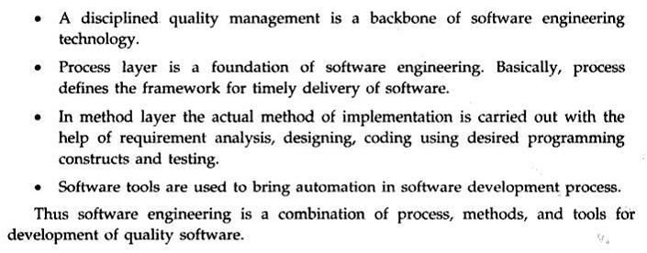

Software Engg: Layered Approach

Slide 6
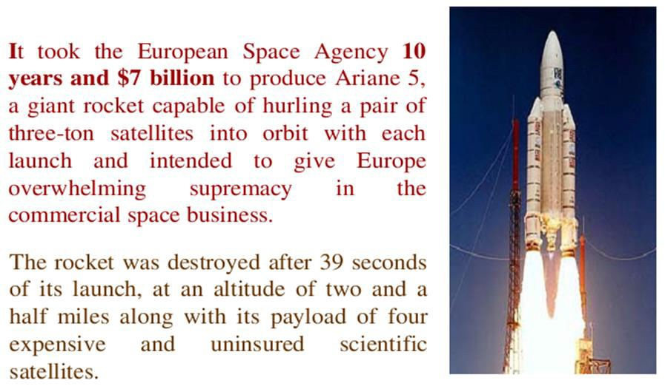
Some Software failures
Ariane 5

Slide 7
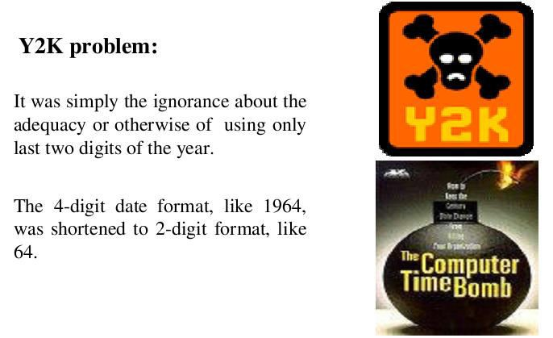
Some Software failures

Slide 8
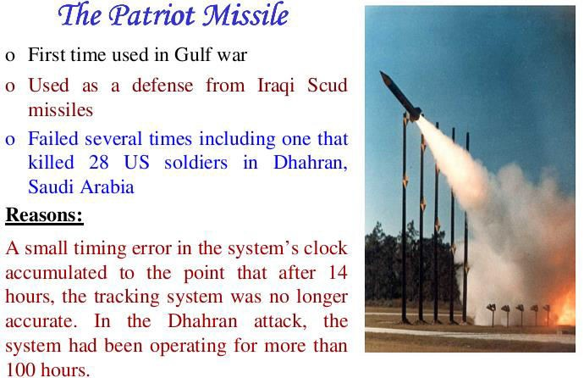
Some Software failures
CSE@HCST 4/27/2016

Slide 9
Some Terminologies
Deliverables and Milestones.
Product and Process.
Measures, Metrics, and Indicators.
Feasibility.
Requirements.
Requirement elicitation.
Software quality assurance.
Cost analysis.
Scheduling.

Slide 10
Deliverables and Milestones-
Deliverables can be agreements or evaluations, normally deliverables are objects, such as source code or user manuals.
Milestones are events that can be used for telling the status of the project. For example, the event of completing the user manual could be a milestone.

Slide 11
Product and Process-
What is delivered to the customer is called the product. It may include source-code specification documents, manuals, documentation, etc. Basically, it is nothing but a set of deliverables only.
Process is the way in which we produce Software. It is the collection of activities that leads to (a part of) a product. An efficient process is required to produce good quality products.
if the process is weak, the end product will undoubtedly suffer.

Slide 12
Measures, Metrics, and Indicators-
In Software
quantitative
engineering
indication of
measures
amount,
provide a
dimension,
capacity, or size of a given attribute of a product.
Metrics are a quantitative measure of the degree to which a system, component, or process possesses a given attribute of a product.
An indicator is a combination of metrics.

Slide 13
Difference between data and information
 | Data | Information
Data is collection of raw facts and figures. |  | Information is processed data.
Data is unarranged and unorganized.. |  | Information is arranged and organized
Data is un-meaningful |  | Information is meaningful.
Data is input. |  | Information is output.
Data is used less frequently. |  | Information is used frequently.
Data represents facts before processing |  | Information represents results ( after processing).
Data is not helpful in decision-making. |  | Information is helpful in decision-making.
Data is raw material for information. |  | Information is the final product of data.
Data are unprocessed records |  | Information contains processed records
Data is in large amounts |  | Information is in small amounts
If data is lost, it is very difficult (or even impossible in some situations) to re collect. |  | If information is lost, it is easily derived from stored data, again.
Data depends upon the sources |  | Information depends upon data

Slide 14
Feasibility, Requirements, Requirement elicitation, Software quality assurance, Cost analysis, Scheduling
Feasibility—Determining if the proposed development
is worth while.
Requirements- Determining what functionality the
Software should contain.
Requirement elicitation- Obtaining the requirements from the user.
Software quality assurance- Determining activities
that will help ensure quality of the product.
Cost analysis—Determining cost estimates.
Scheduling—Building a schedule for the development.

